Slide 1
Using HLS IP in a Zynq SoC Design
R09921132 劉彥甫
Lab #A - UG871

Slide 2
Agenda
Vitis Development Flow
01
Vitis Introduction
Pynq Z2 Board settings
Vitis Development Flow for Pynq Z2
Lab1 MAC
02
How to do HLS in Vitis_HLS
How to do Analysis in Vitis_HLS
How to do System design in Vivado
Interrupt or not in Vitis
Lab2 FFT
03
How to do HLS in Vitis_HLS
How to do System design in Vivado
How to do Data Streaming in Vitis

Slide 3
Vitis Development Flow
01
Vitis Introduction
Pynq Z2 Board settings
Vitis Development Flow for Pynq Z2

Slide 4
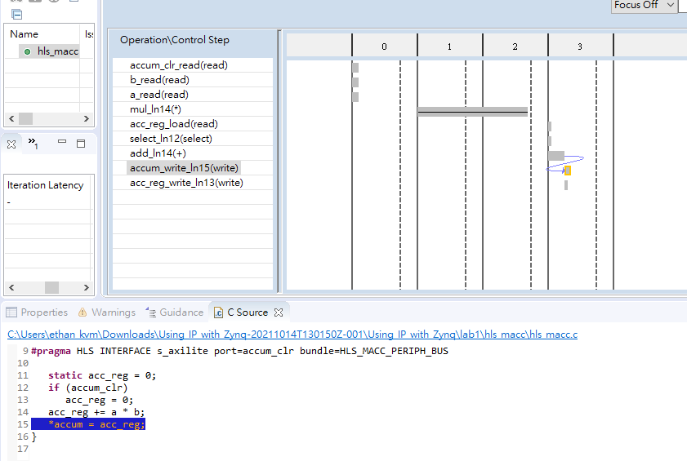
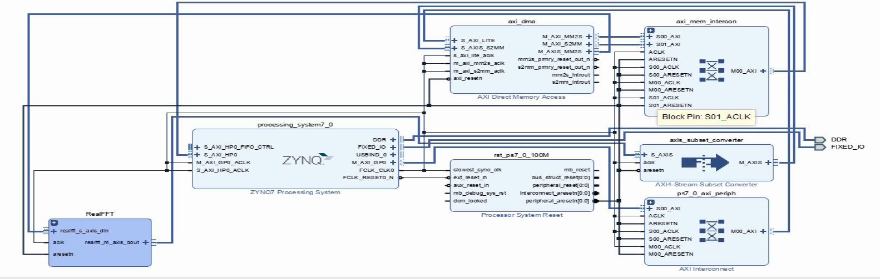
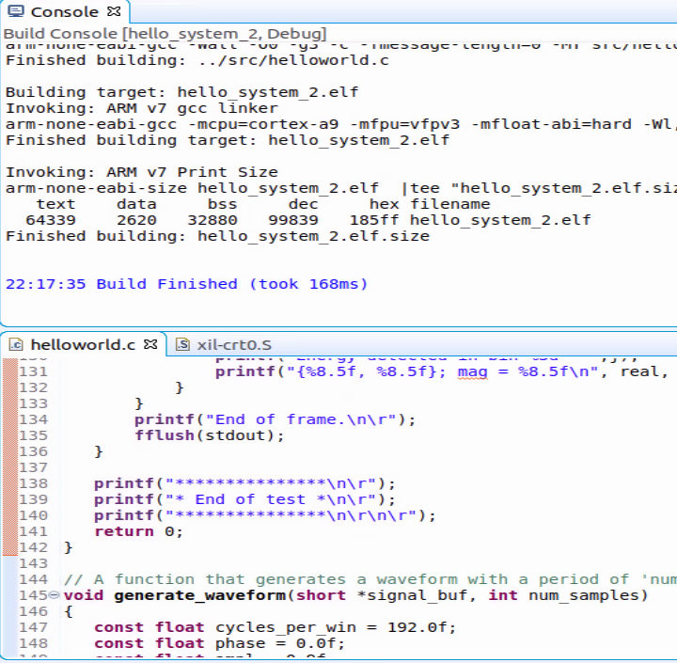



From hardware design to software design
Vitis_HLS
Vivado
Vitis
Function Design
System Design
Software Design
Use C/C++ to fast build a function correct hardware with fast design space exploration
Use block diagram to build a system architecture with IPs
Create software application on hardware platform with APIs.

Slide 5
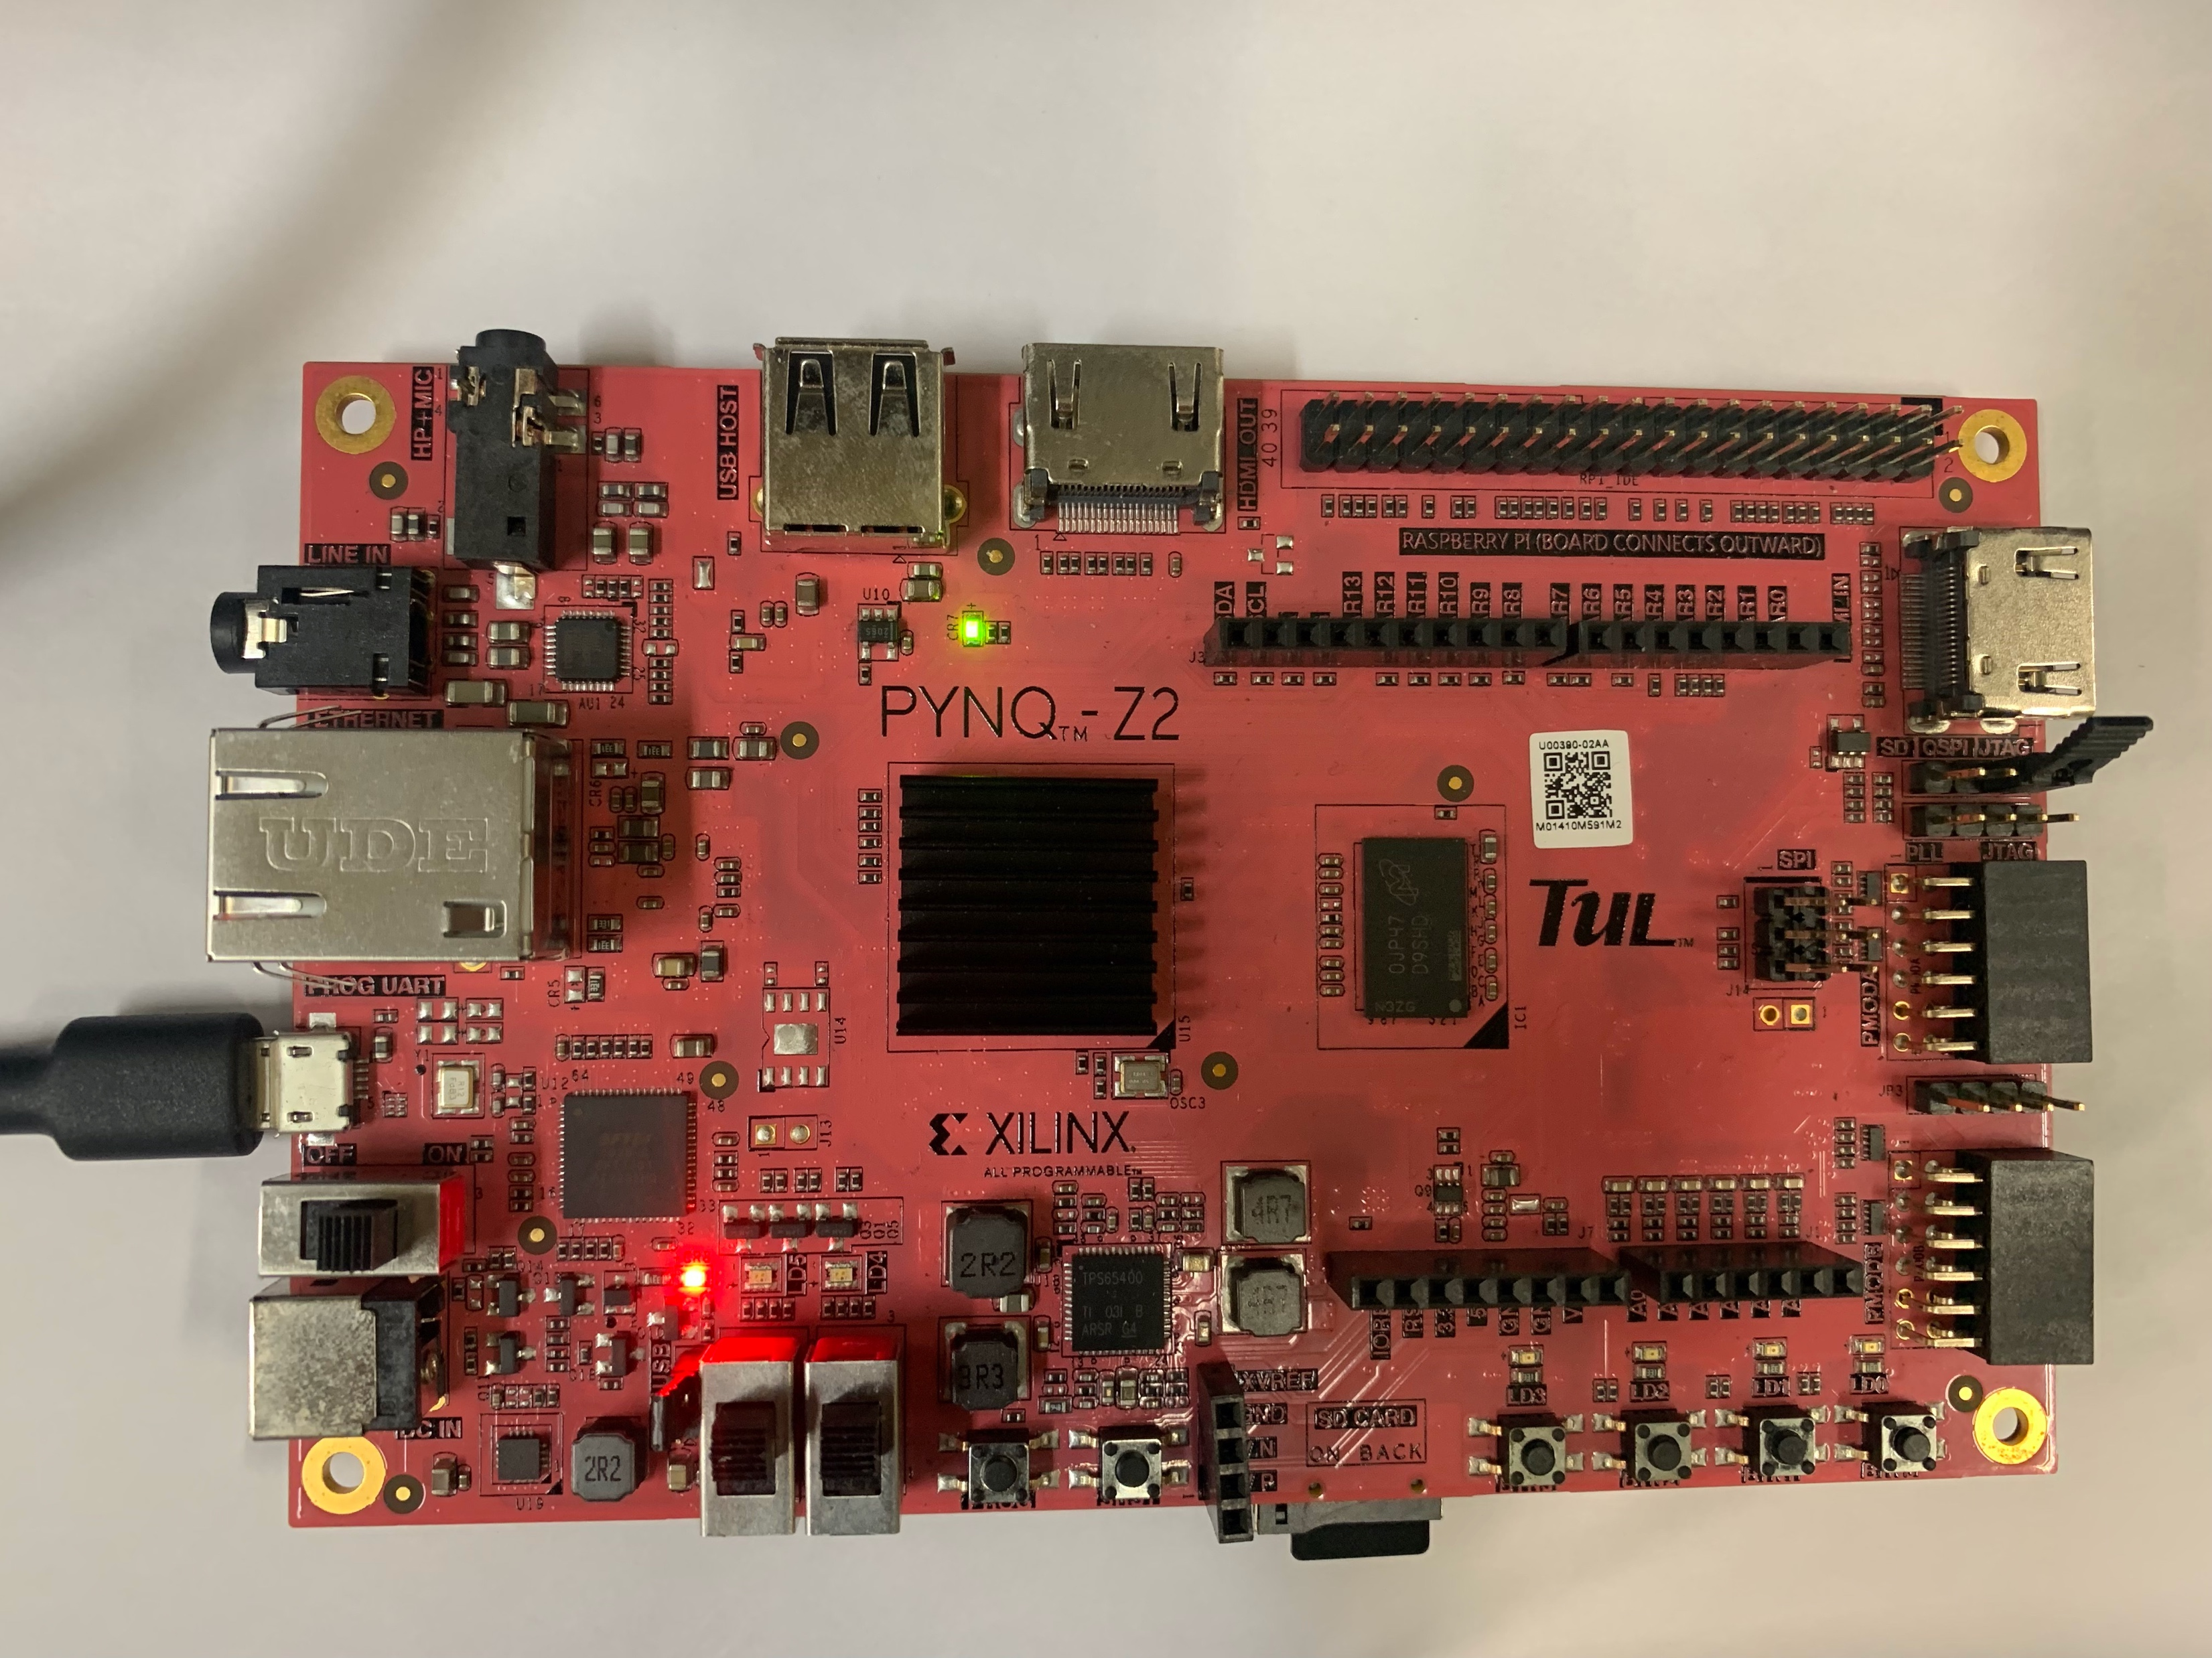
Pynq Z2 Board settings
Program-> JTAG
USB to PC
Power -> USB

Slide 6
Vitis Development Flow
Co-Sim/Gen IP
Export hardware
Make sure the code work in RTL as we expected and export RTL IP.
Generate bitstream and XSA file for HW/SW co-design.
Step 1
Step 3
Step 5
Step 2
Step 4
Vitis HLS
System level design
Design software
Write function and optimize function with design space
exploration.
Use block diagram to design system with different IPs.
Use Vitis to design Data accelerated computing application.

Slide 7
Lab1 MAC
02
How to do HLS in Vitis_HLS
How to do Analysis in Vitis_HLS
How to do System design in Vivado
Interrupt or not in Vitis

Slide 8
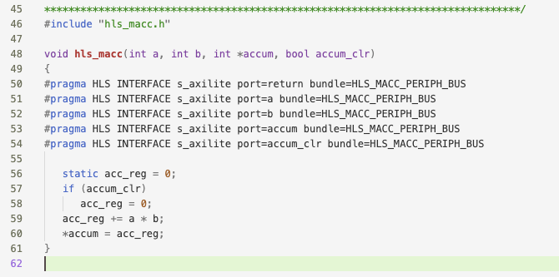
How to do HLS in Vitis HLS
bundle=<string>:
Groups function arguments into AXI interface ports. By default, Vivado HLS groups all function arguments specified as an AXI4-Lite (s_axilite) interface into a single AXI4-Lite port.

Slide 9
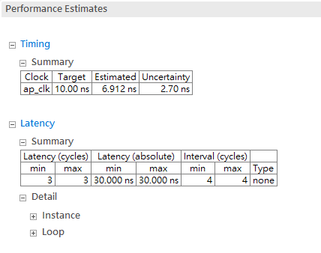
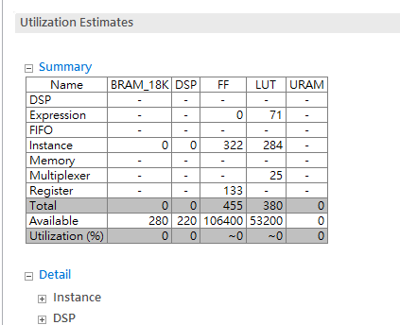
How to do Analysis in Vitis HLS

Slide 10
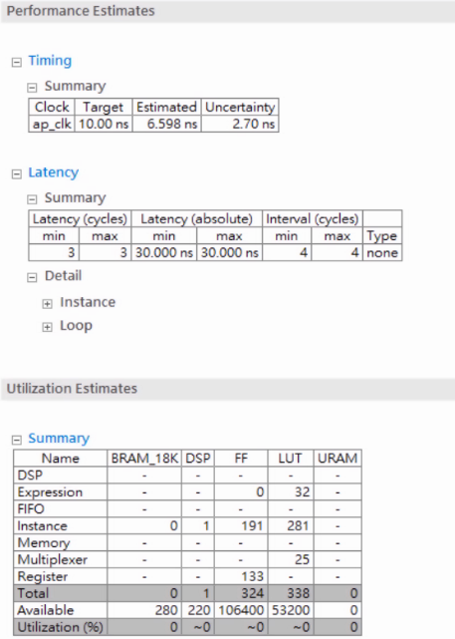
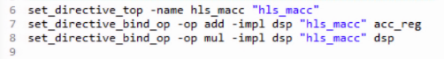
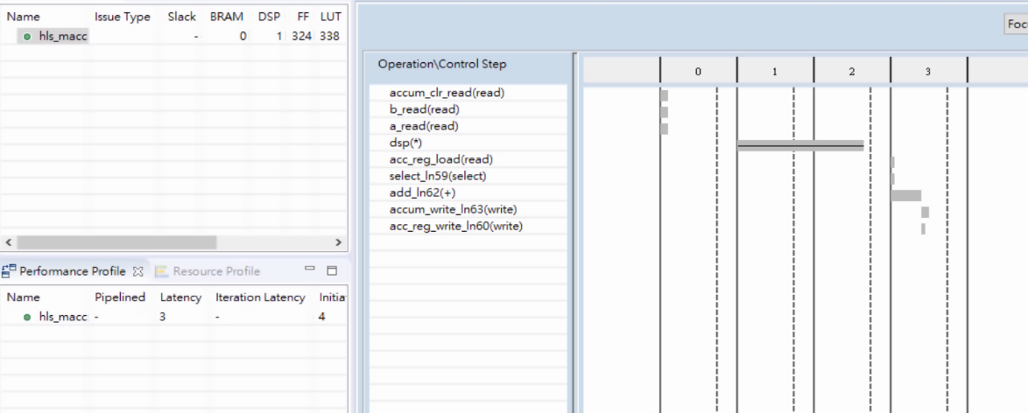
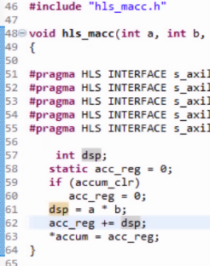
How to do Analysis in Vitis HLS

Slide 11
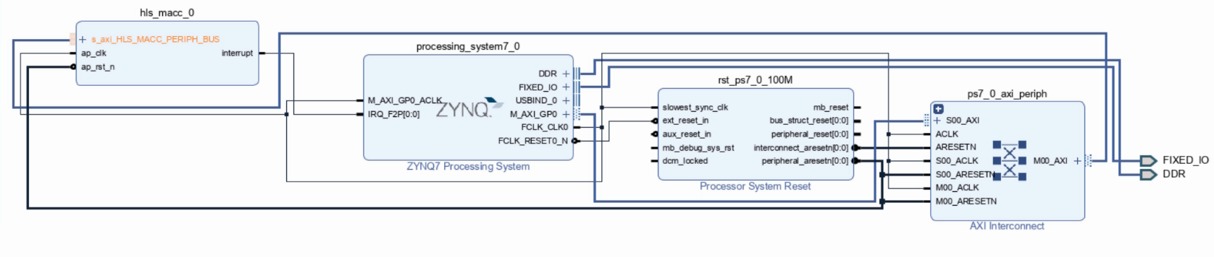
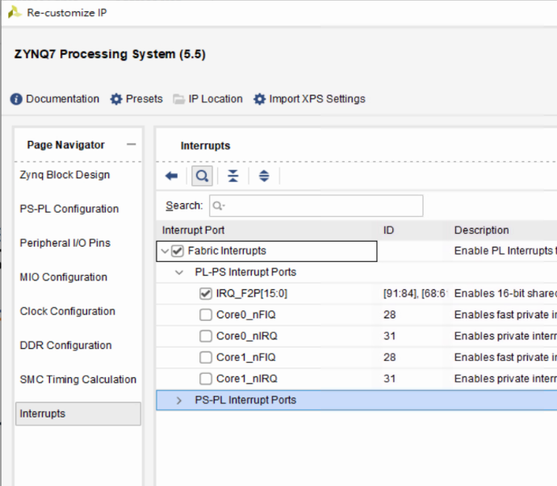
How to do System design in Vivado

Slide 12
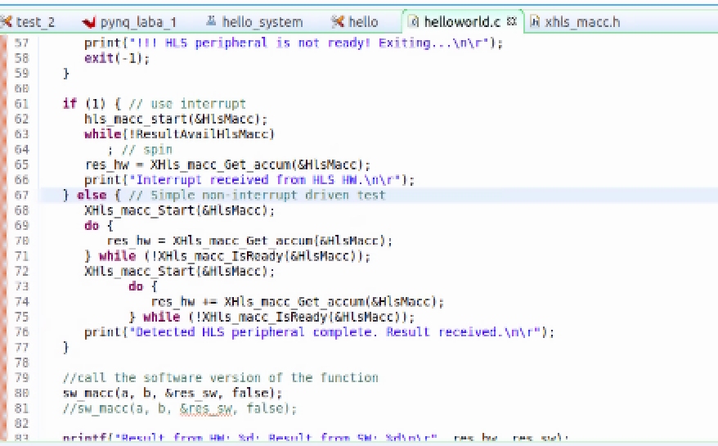
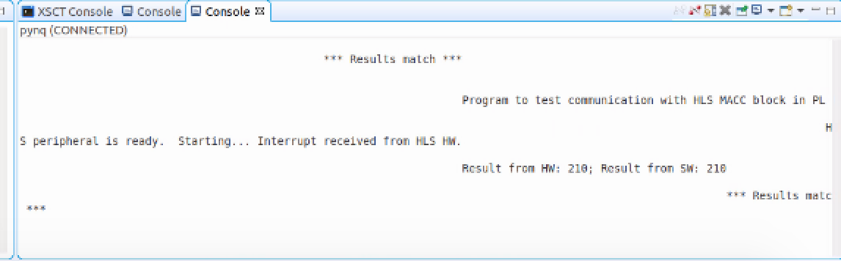
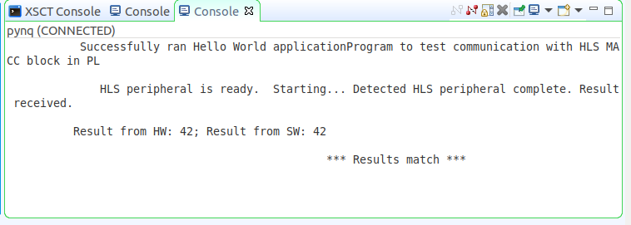
Interrupt or not in Vitis

Slide 13
Lab2 FFT
03
How to do HLS in Vitis_HLS
How to do System design in Vivado
How to do Data Accelerate in Vitis

Slide 14
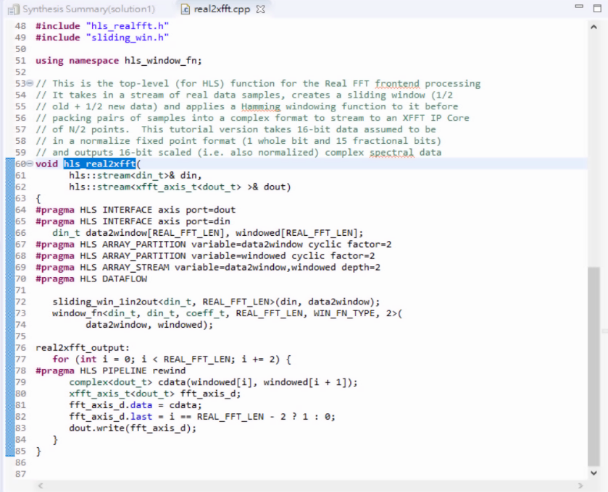
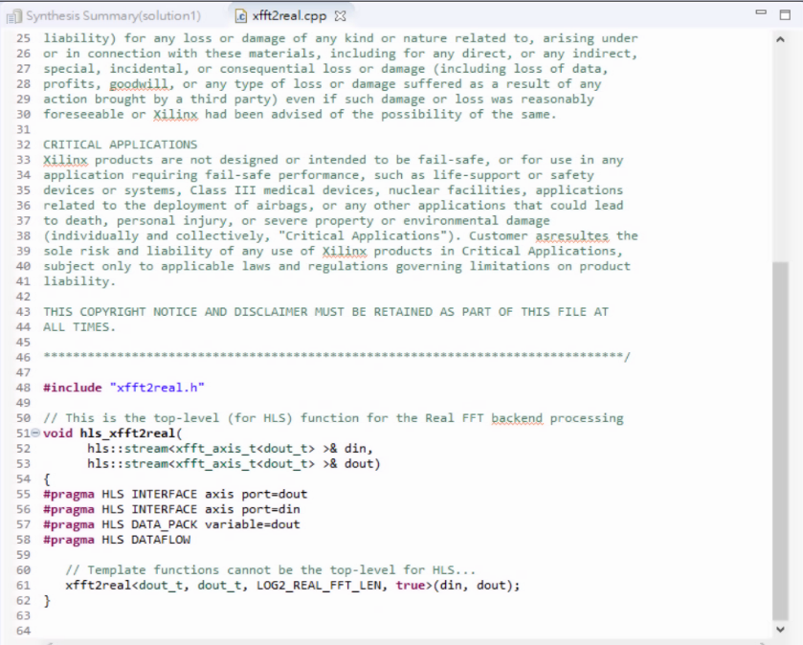
How to do HLS in Vitis HLS
Front end
Back end

Slide 15
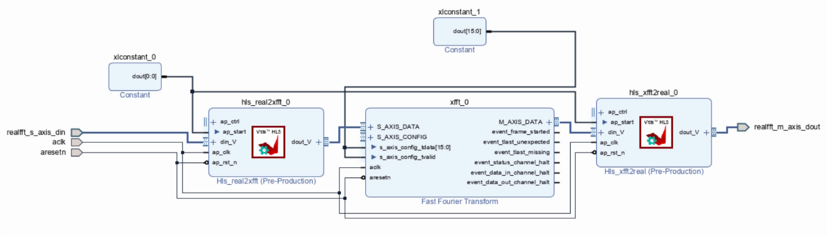
How to do System Design in vivado
RealFFT module
(one hierachy)

Slide 16
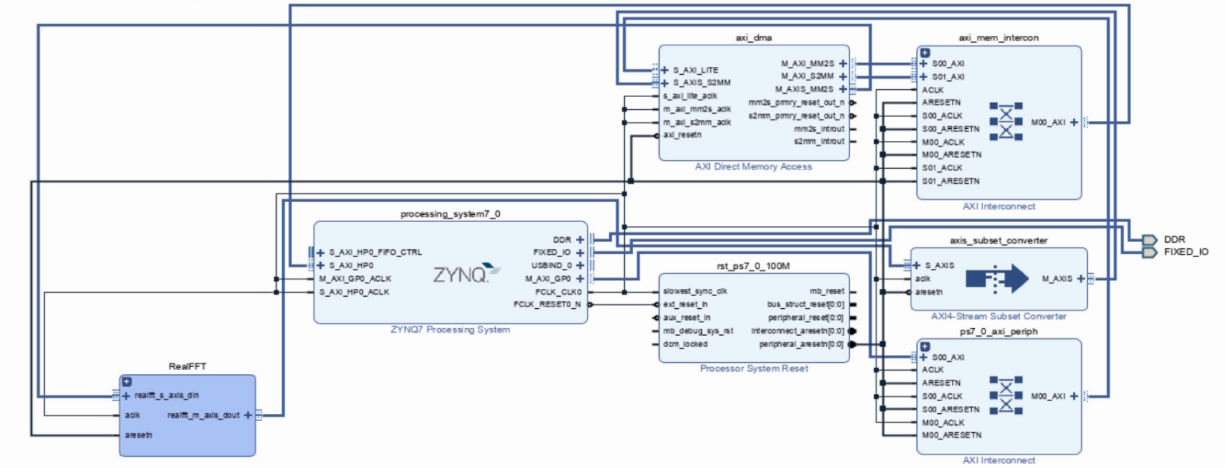
How to do System Design in vivado

Slide 17
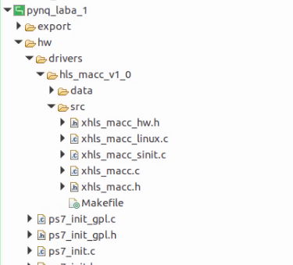
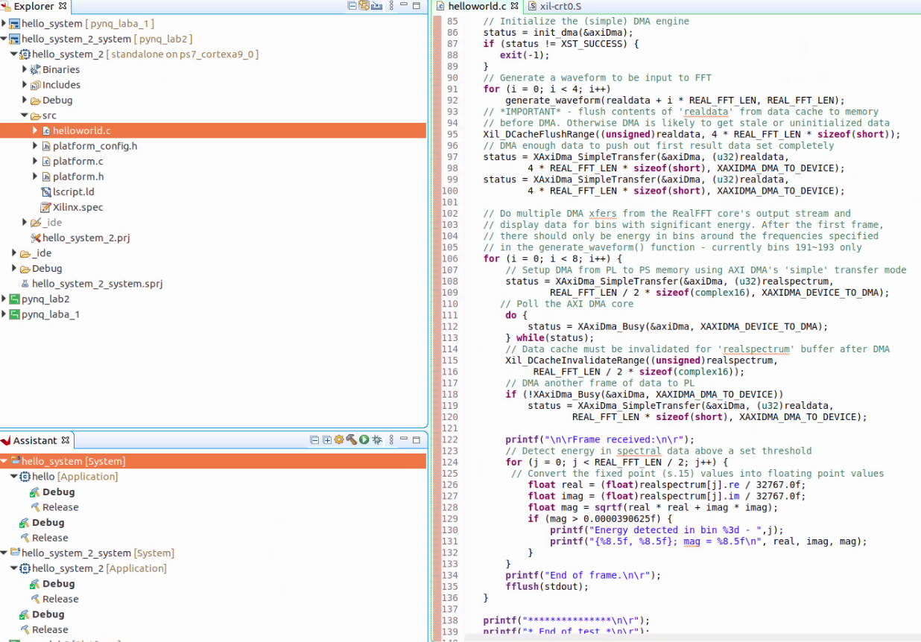
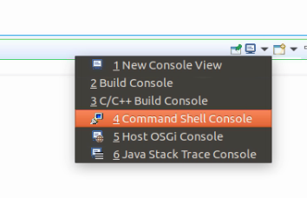
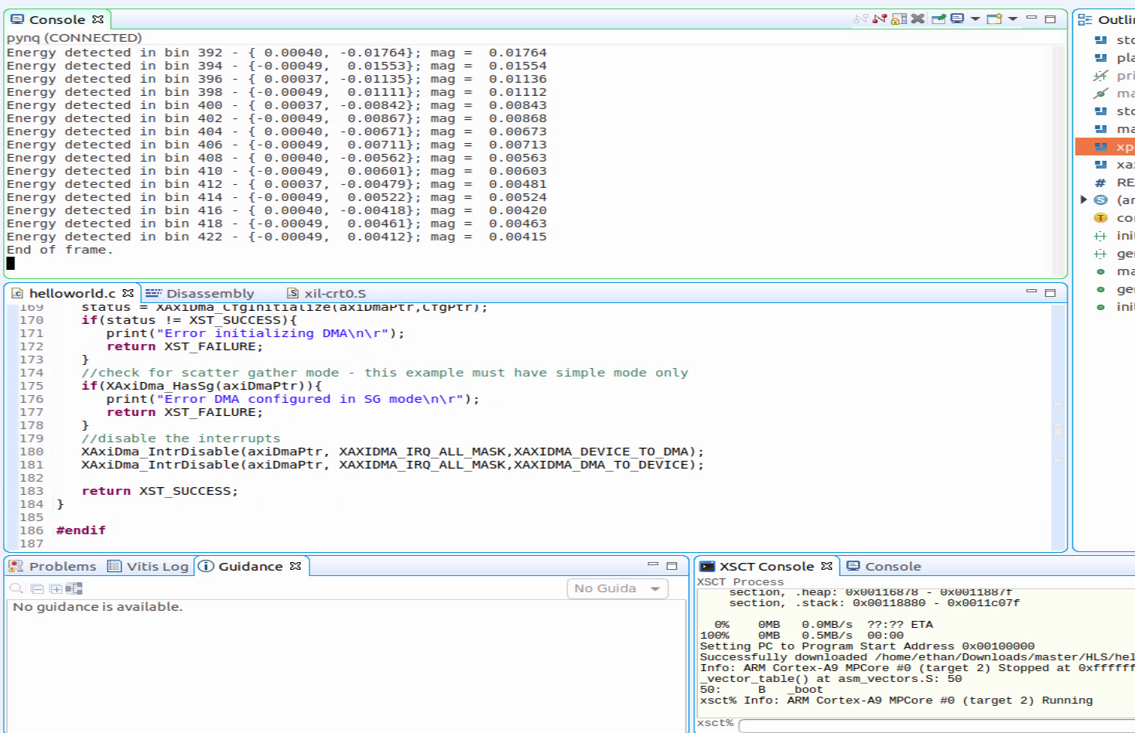
How to do Data Accelerate in Vitis
Export hardware platform .xsa file in Vivado(including bitstream).
Create a Vitis Platform project.
Create a application.

Slide 18
GitHub
# The file hierarchy is:
```
├── Lab1
│ ├── vitis
│ │ ├── hello
│ │ ├── hello_system
│ │ └── pynq_laba_1
│ ├── vitis_hls
│ │ └── use_ip_on_zynq_lab1
│ └── vivado
│ └── hls_ip_zynq_lab1
├── Lab2
│ ├── vitis
│ │ ├── hello_system_2
│ │ ├── hello_system_2_system
│ │ └── pynq_lab2
│ ├── vitis_hls
│ │ ├── zynq_lab_2_2020
│ │ └── zynq_lab_2_2020_be
│ └── vivado
│ └── hls_ip_zynq_lab2
├── Reference_code
│ └── Using_IP_with_Zynq
│ ├── lab1
│ └── lab2
└── Slide_report
├── Lab_A_R09921132_劉彥甫.pdf
└── Lab_A_R09921132_劉彥甫.pptx
24 directories, 2 files
```
https://github.com/Waxpple/Using-HLS-IP-in-a-Zynq-Soc-Design

Slide 19
THANK YOU
Insert the Subtitle of Your Presentation

